Slide 1
AIR HANDLING UNIT
DRYERKOREA CO.,LTD.

Slide 2
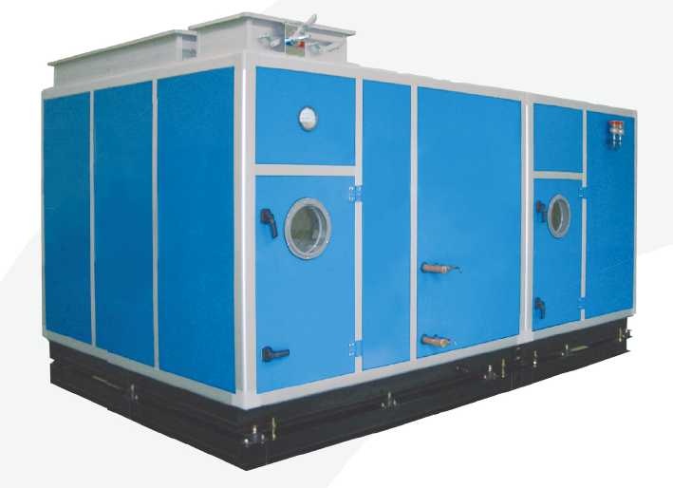
AIR HANDLING UNIT
A.H.U / E.H.P / G.H.P
DRYERKOREA CO.,LTD.

Slide 3
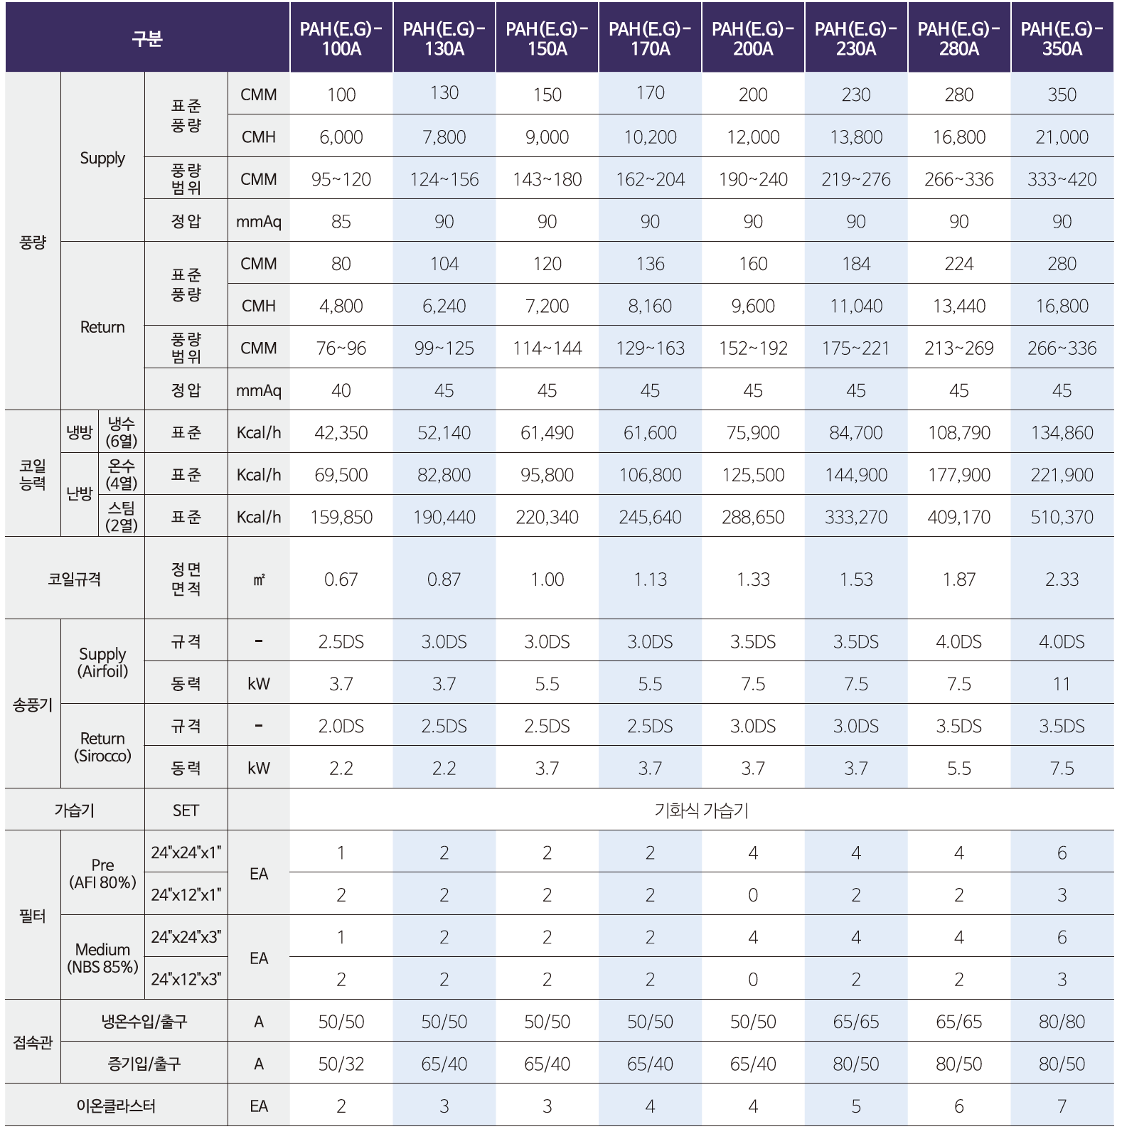
Air Handling Unit
PAH[E.G] 100A~1250A
DRYERKOREA CO.,LTD.

Slide 4
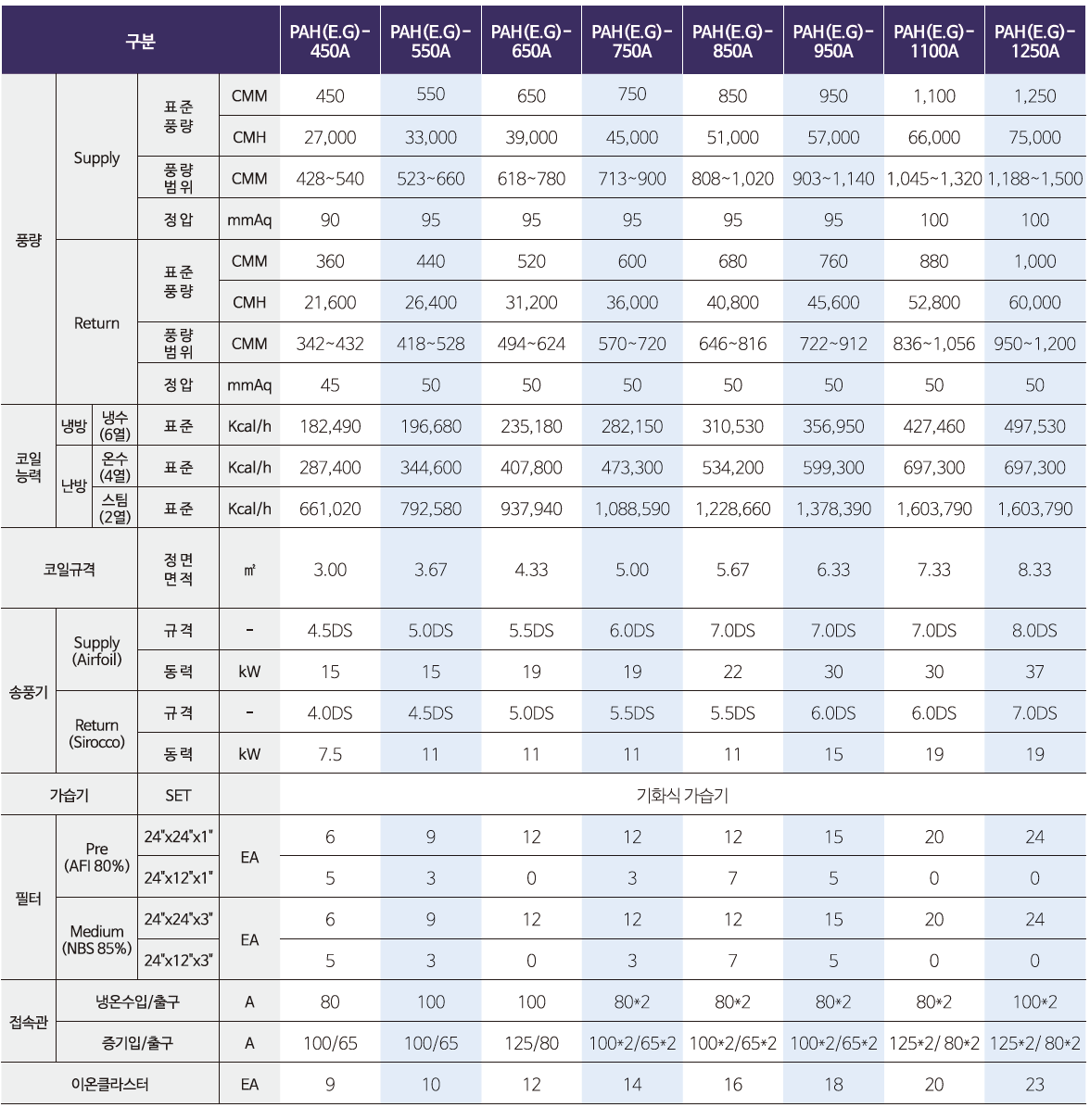
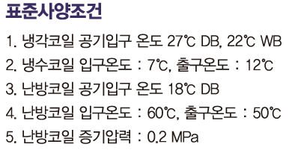
Air Handling Unit
PAH[E.G] 100A~1250A
DRYERKOREA CO.,LTD.

Slide 5
Air Handling Unit
PAH[E.G] 100A~1250A
㈜ 드라이어코리아

Slide 6
Air Handling Unit
PAH[E.G] 100A~1250A
DRYERKOREA CO.,LTD.

Slide 7
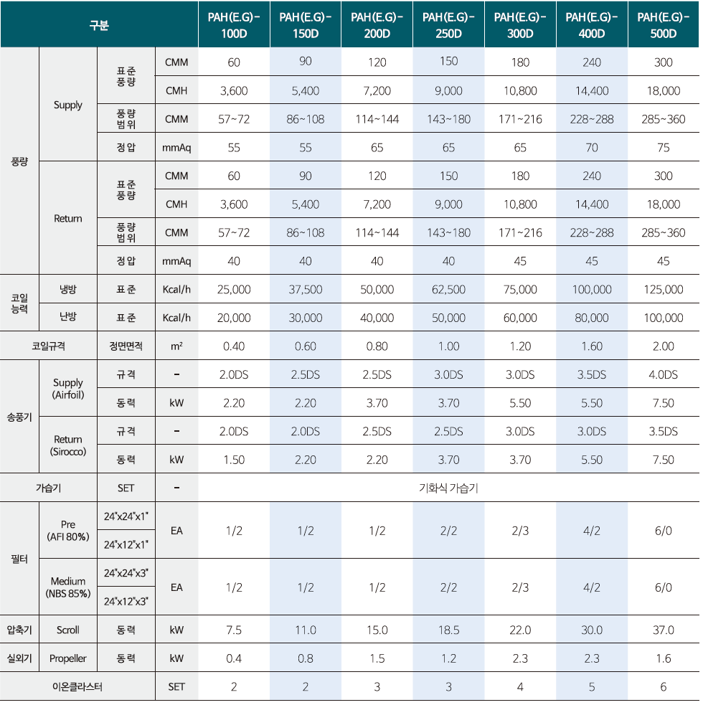
Air Handling Unit - E.H.P
PAH[E.G] 100D~1200D
㈜ 드라이어코리아

Slide 8
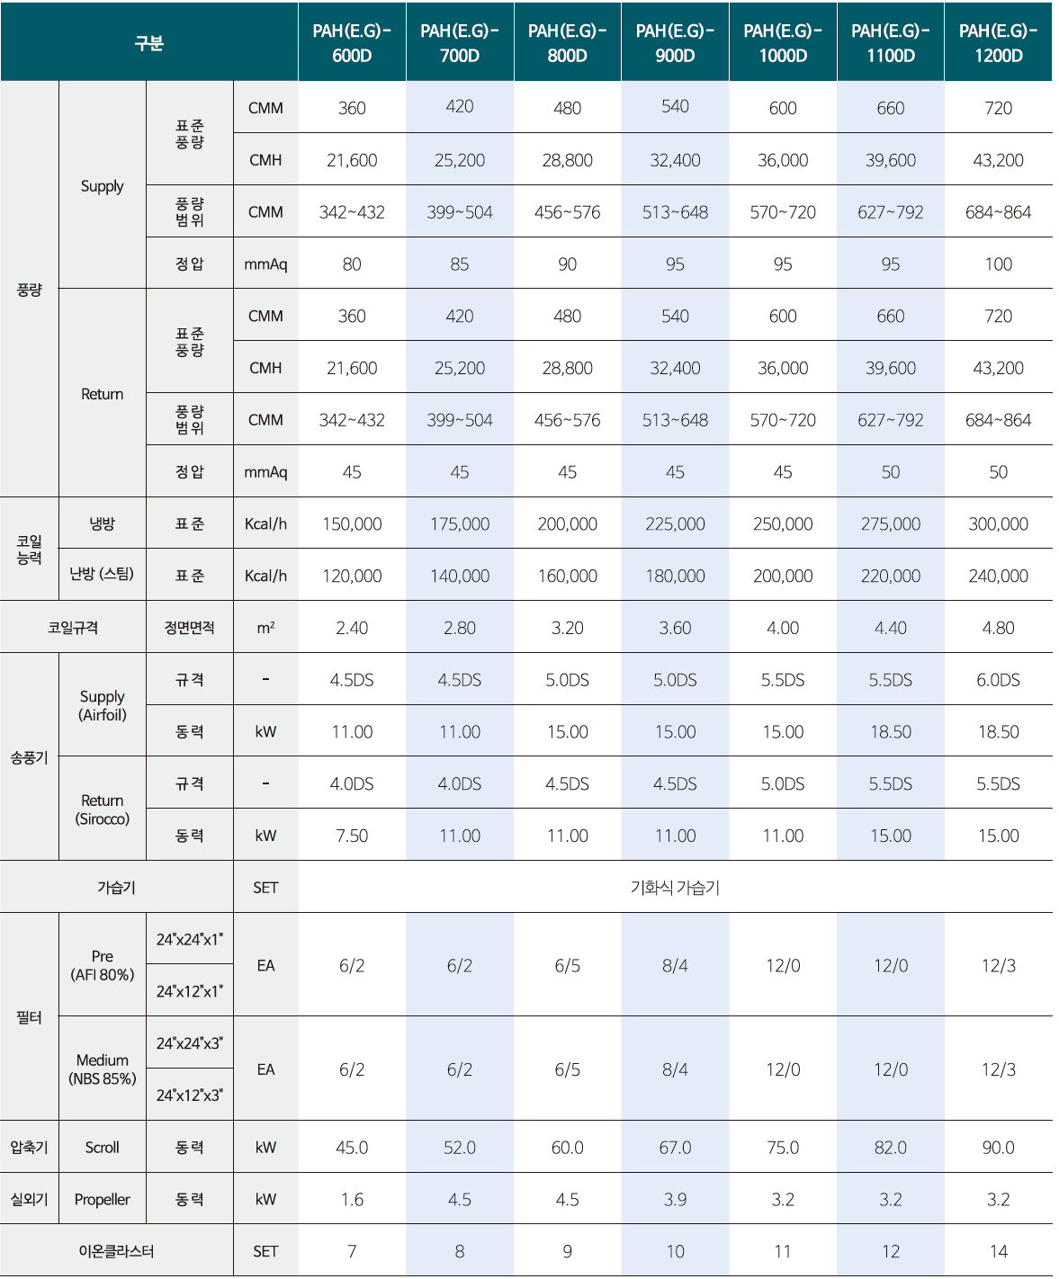
Air Handling Unit - E.H.P
PAH[E.G] 100D~1200D
DRYERKOREA CO.,LTD.

Slide 9
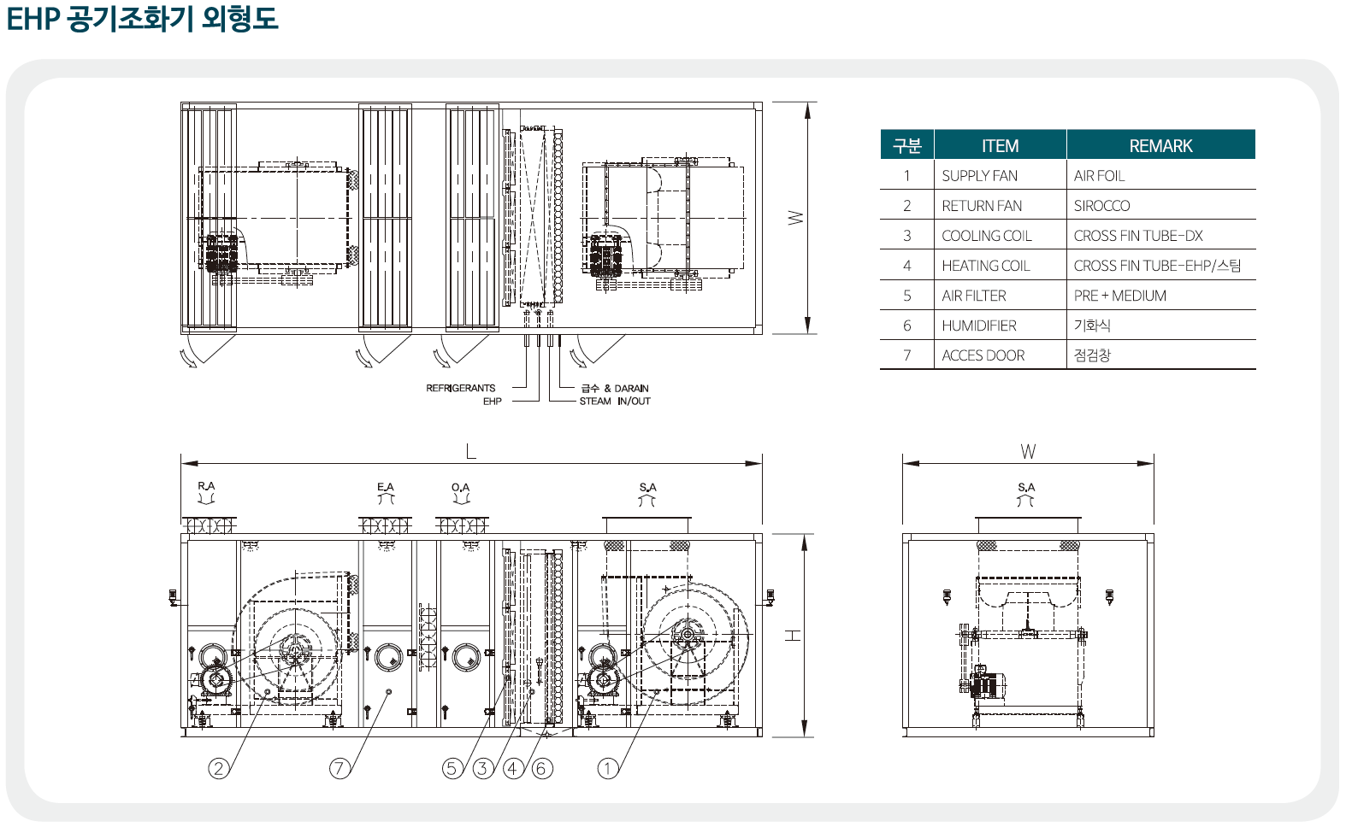
Air Handling Unit - E.H.P
PAH[E.G] 100D~1200D
㈜ 드라이어코리아

Slide 10
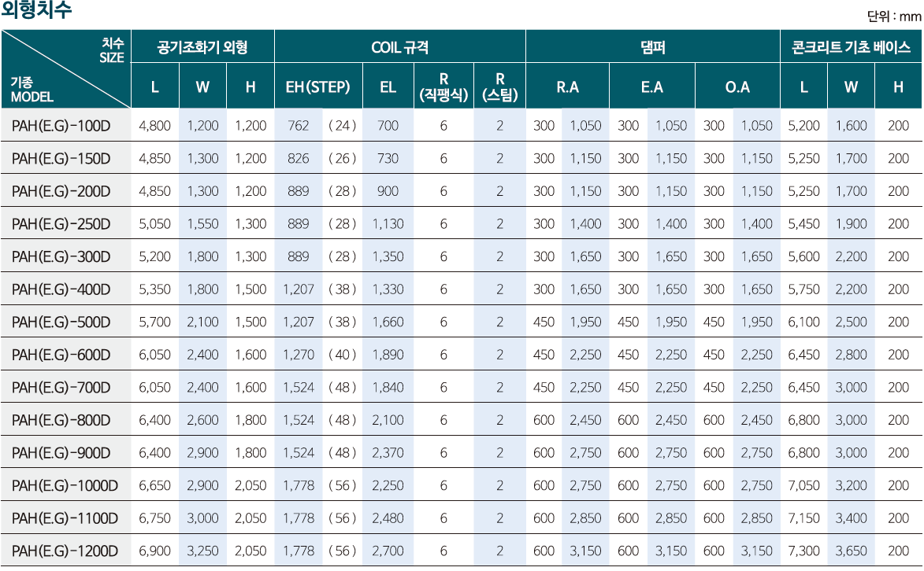
Air Handling Unit - E.H.P
PAH[E.G] 100D~1200D
DRYERKOREA CO.,LTD.

Slide 11
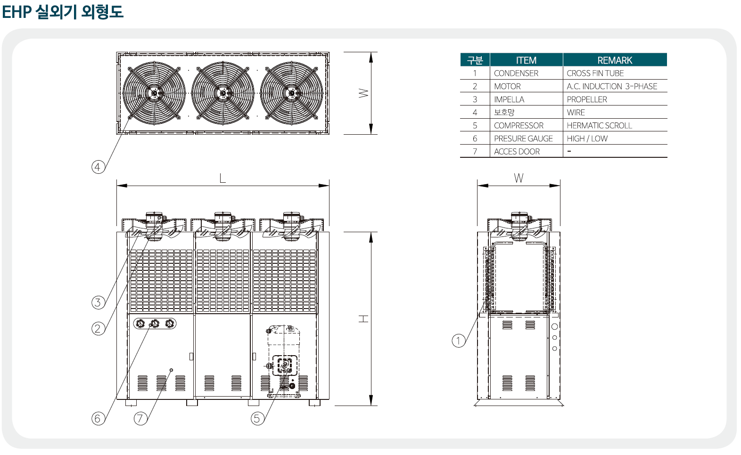
Air Handling Unit - E.H.P
PAH[E.G] 100D~1200D
DRYERKOREA CO.,LTD.

Slide 12
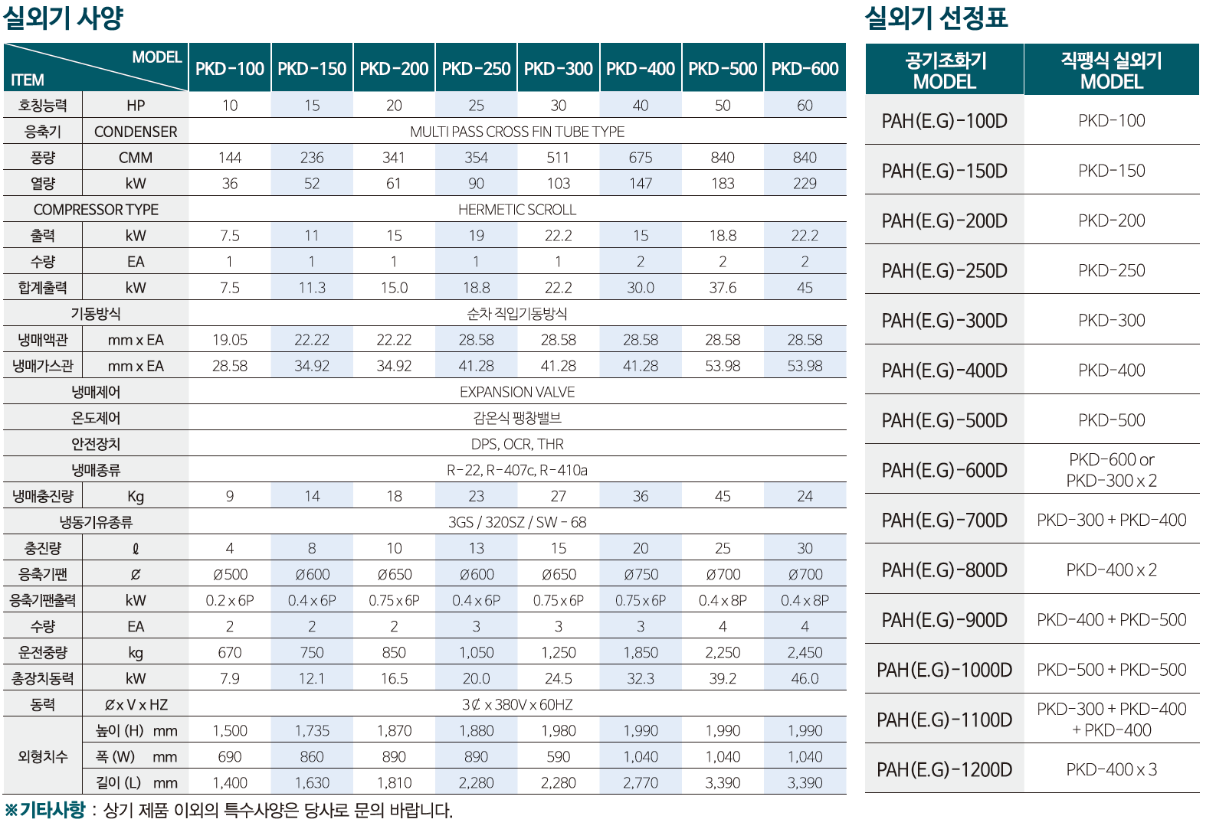
Air Handling Unit - E.H.P
PAH[E.G] 100D~1200D
DRYERKOREA CO.,LTD.

Slide 13
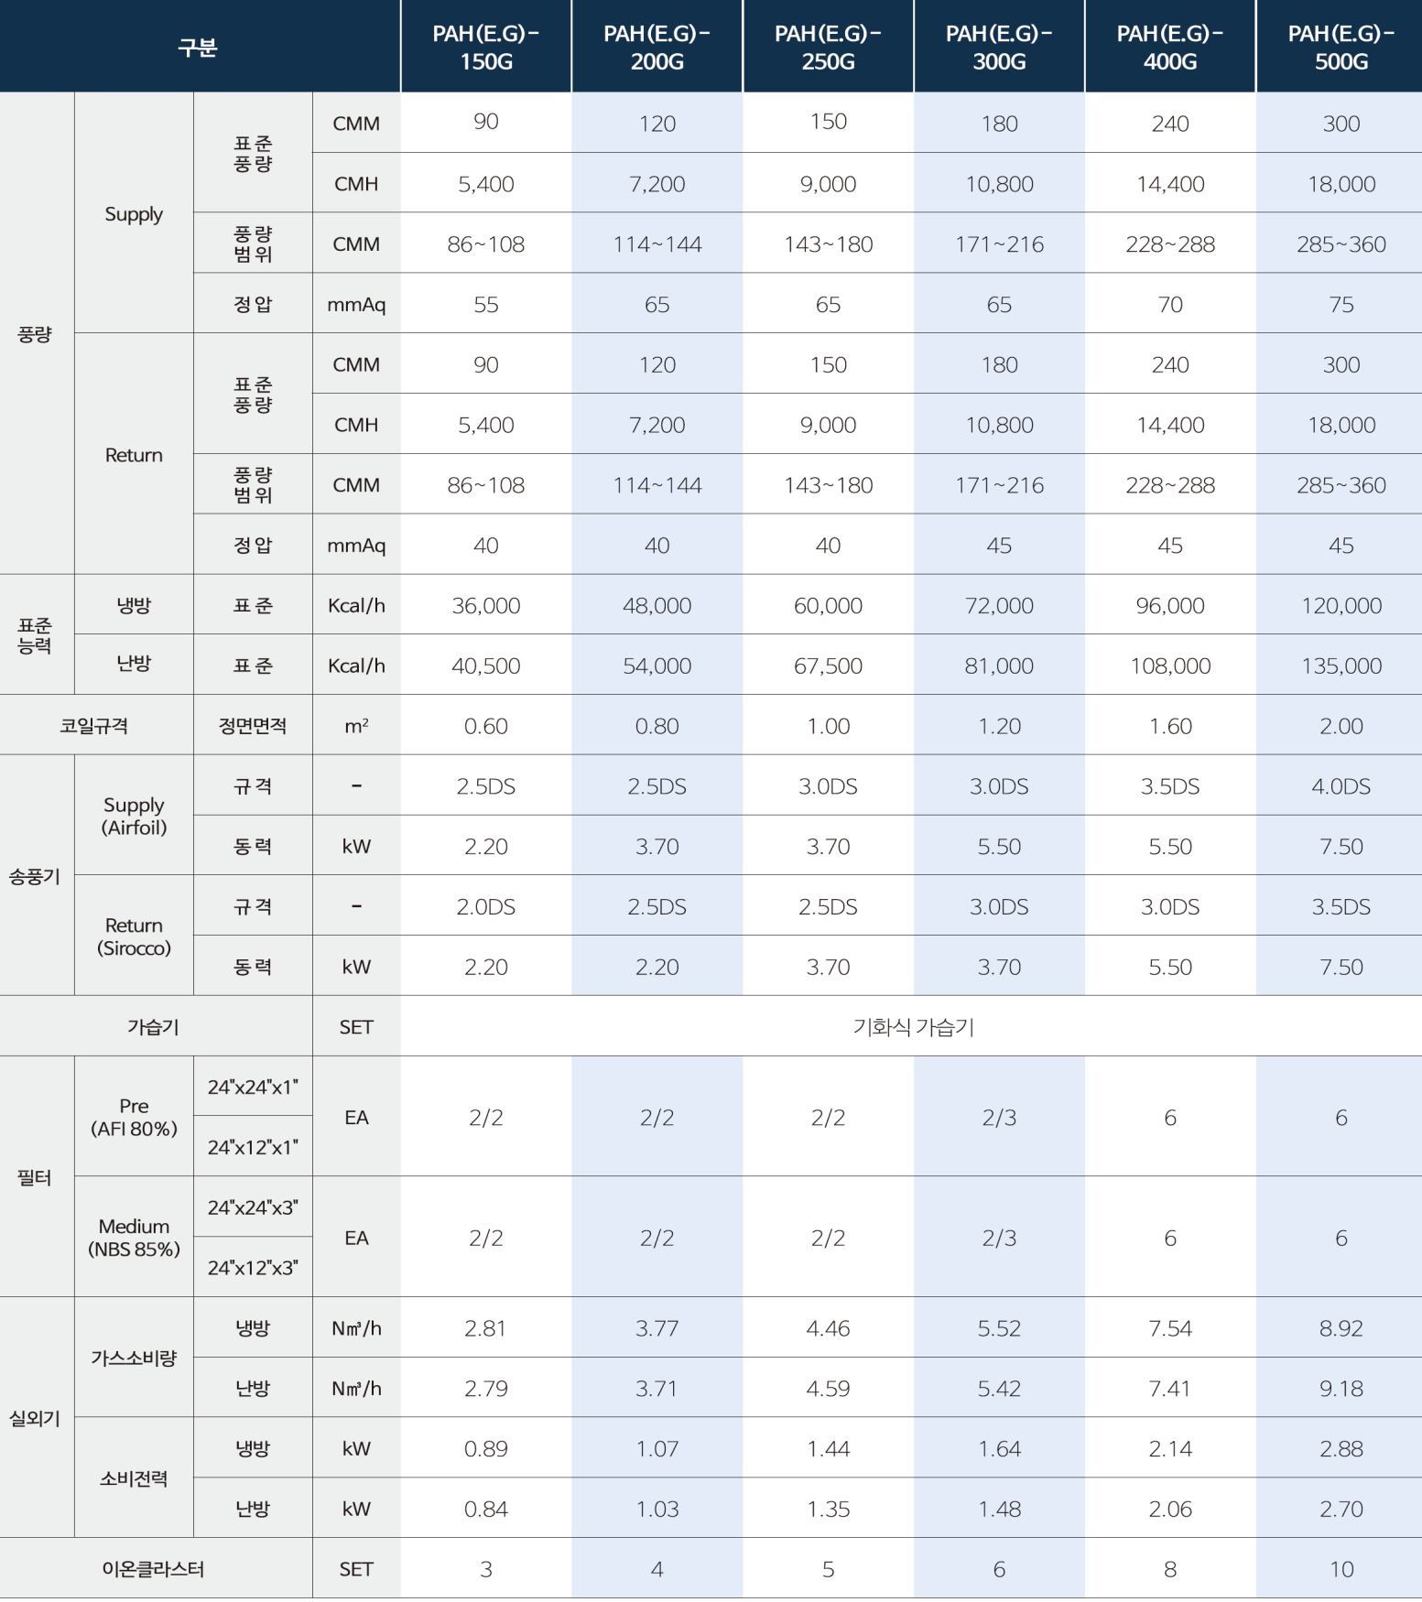
Air Handling Unit - G.H.P
PAH[E.G] 150G~1200G
DRYERKOREA CO.,LTD.

Slide 14
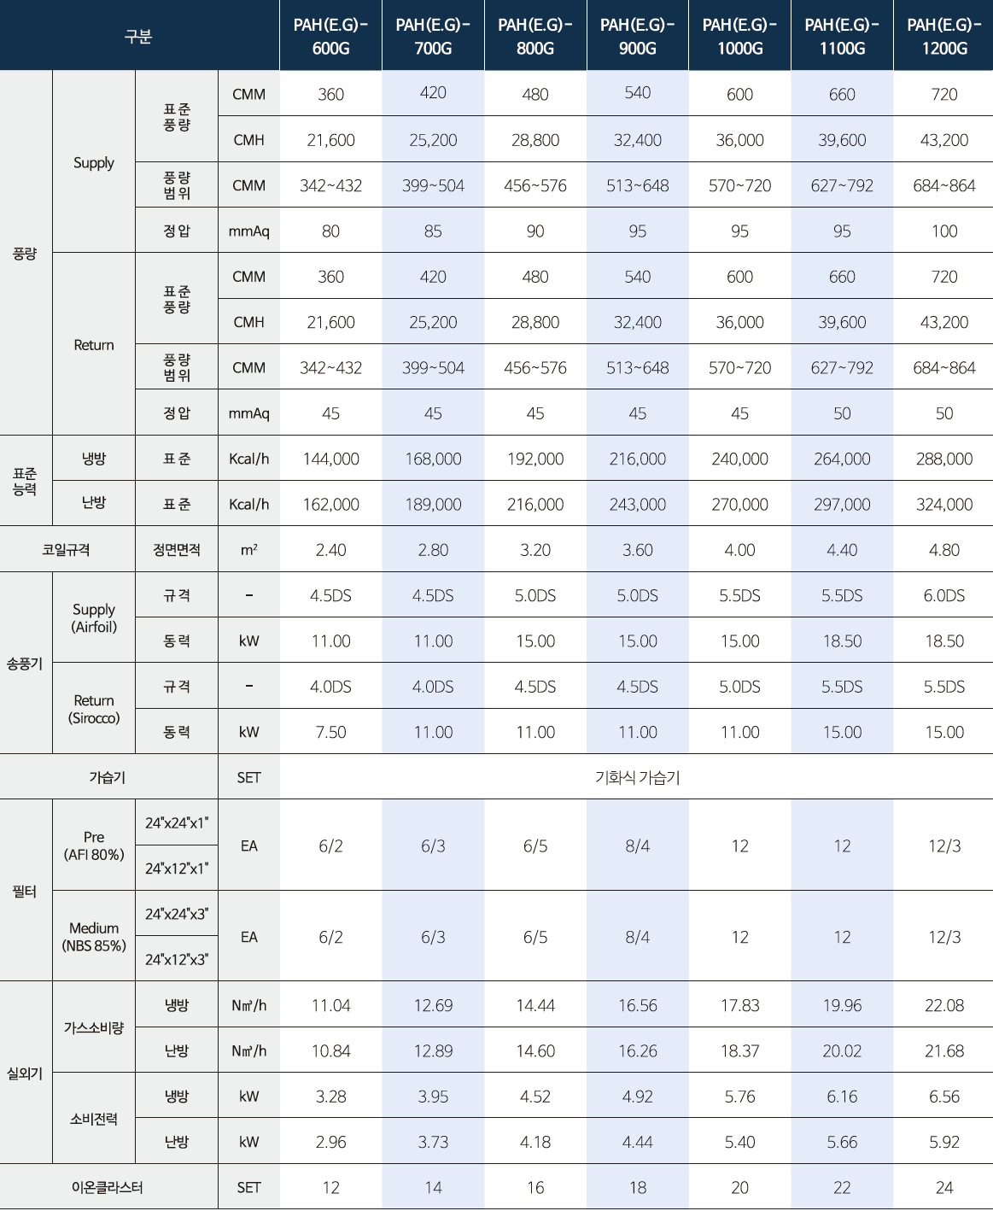
Air Handling Unit - G.H.P
PAH[E.G] 150G~1200G
DRYERKOREA CO.,LTD.

Slide 15
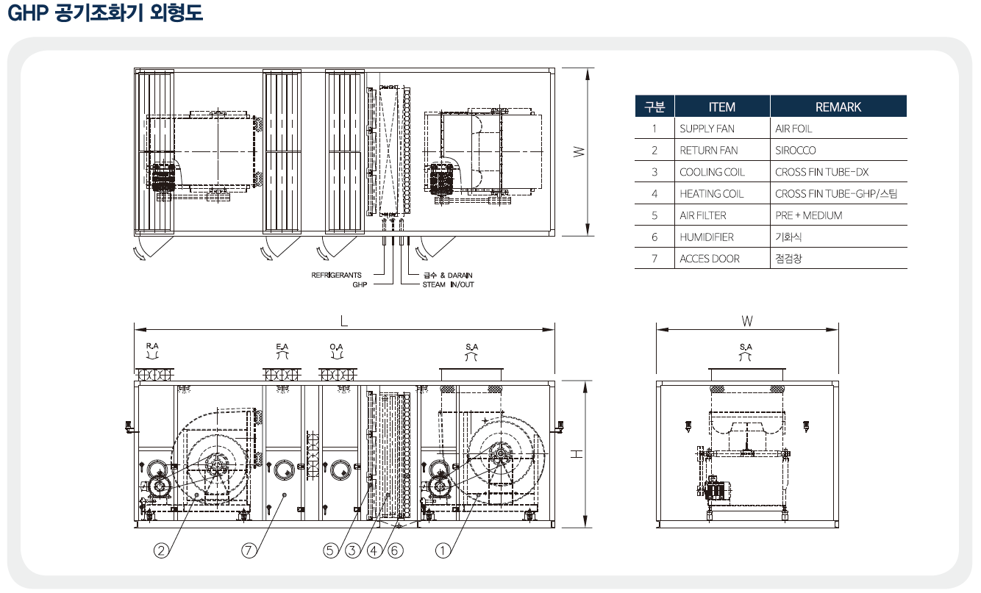
Air Handling Unit - G.H.P
PAH[E.G] 150G~1200G
DRYERKOREA CO.,LTD.

Slide 16
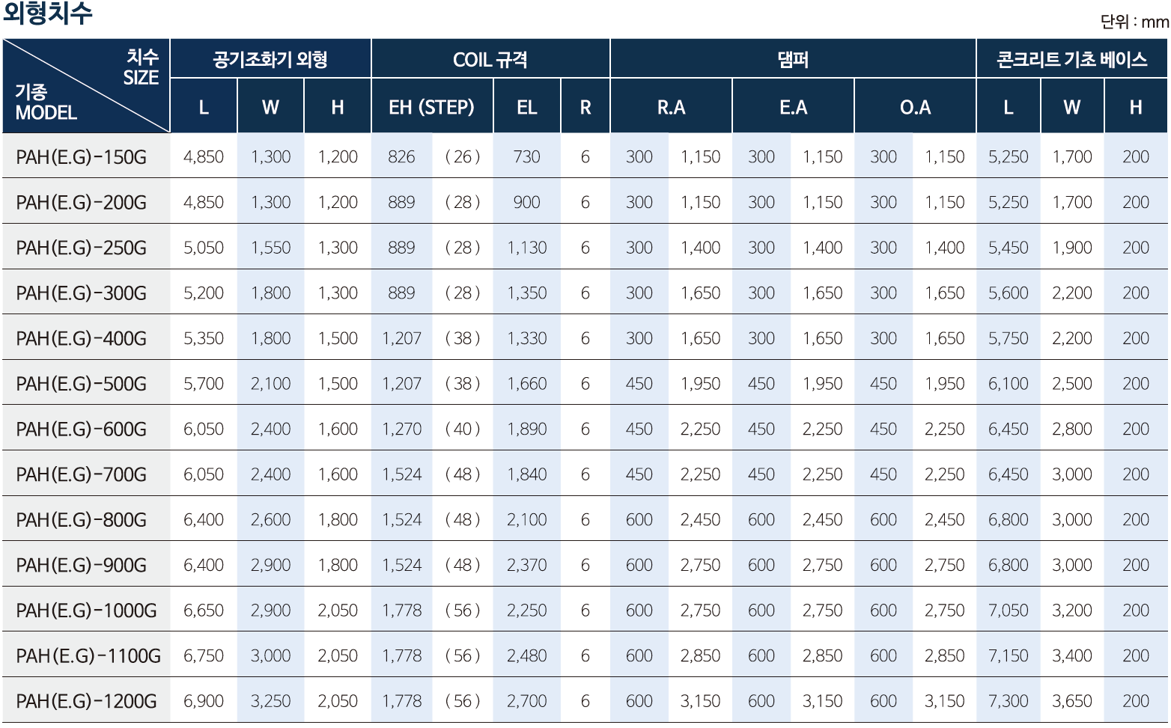
Air Handling Unit - G.H.P
PAH[E.G] 150G~1200G
DRYERKOREA CO.,LTD.

Slide 17
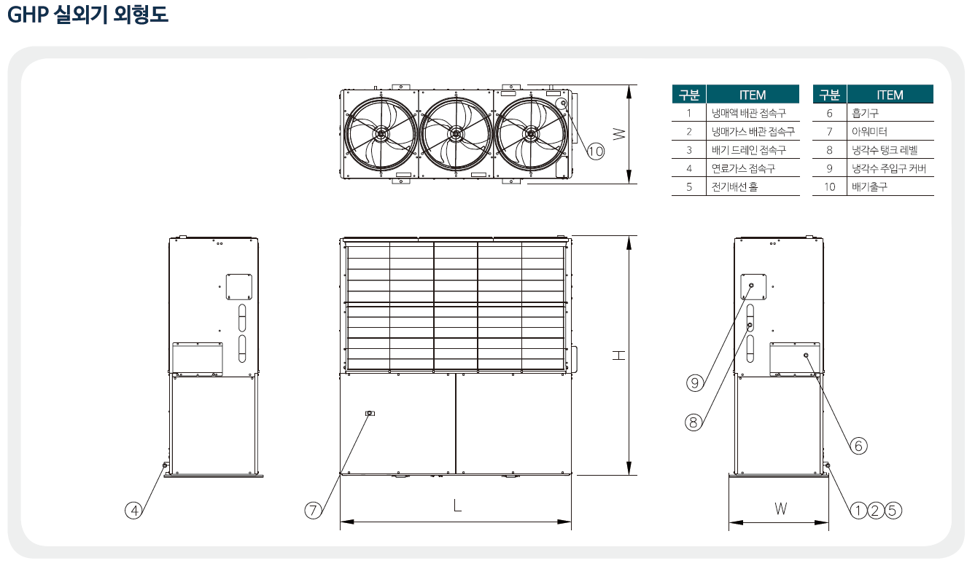
Air Handling Unit - G.H.P
PAH[E.G] 150G~1200G
DRYERKOREA CO.,LTD.

Slide 18
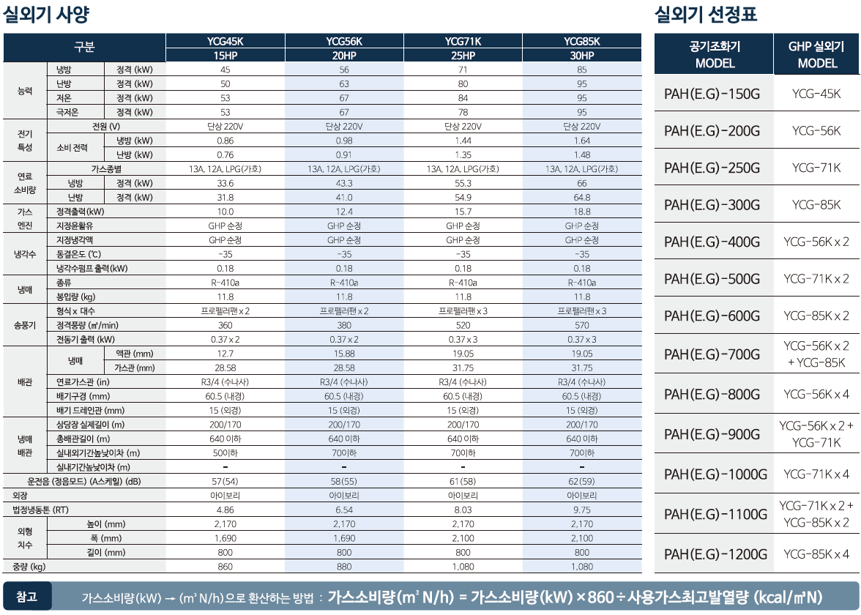
Air Handling Unit - G.H.P
PAH[E.G] 150G~1200G
DRYERKOREA CO.,LTD.

Slide 19
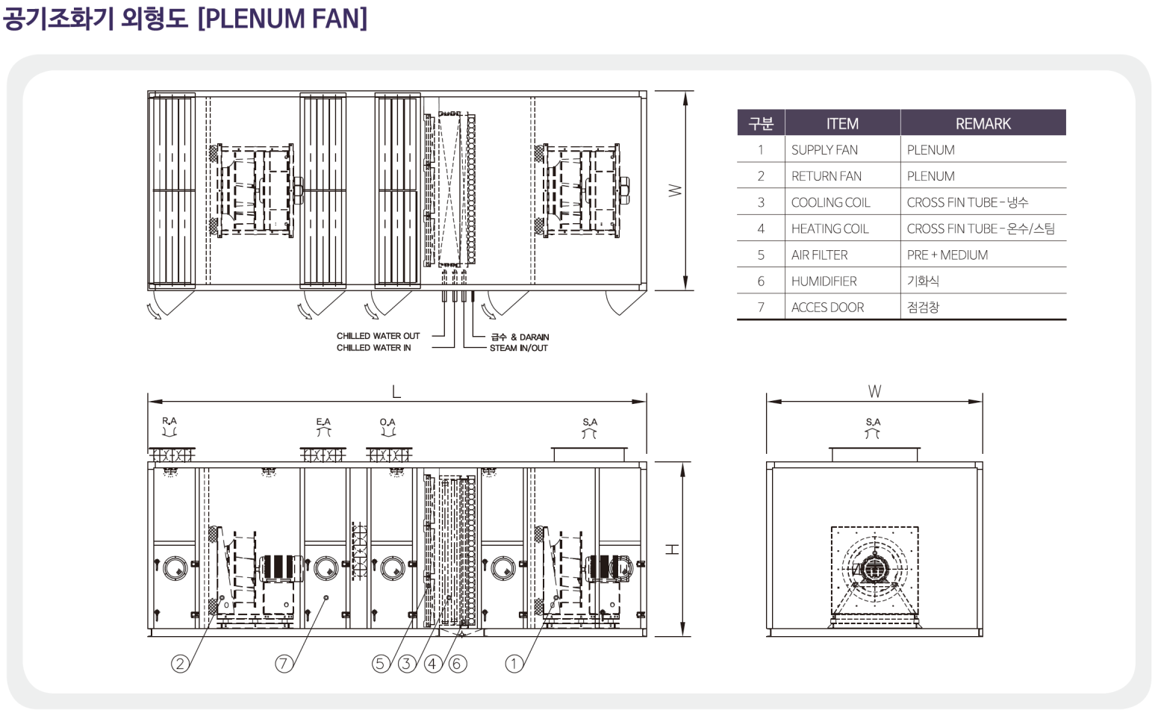
Air Handling Unit
PAH[E.G] 100A~1250A
DRYERKOREA CO.,LTD.

Slide 20
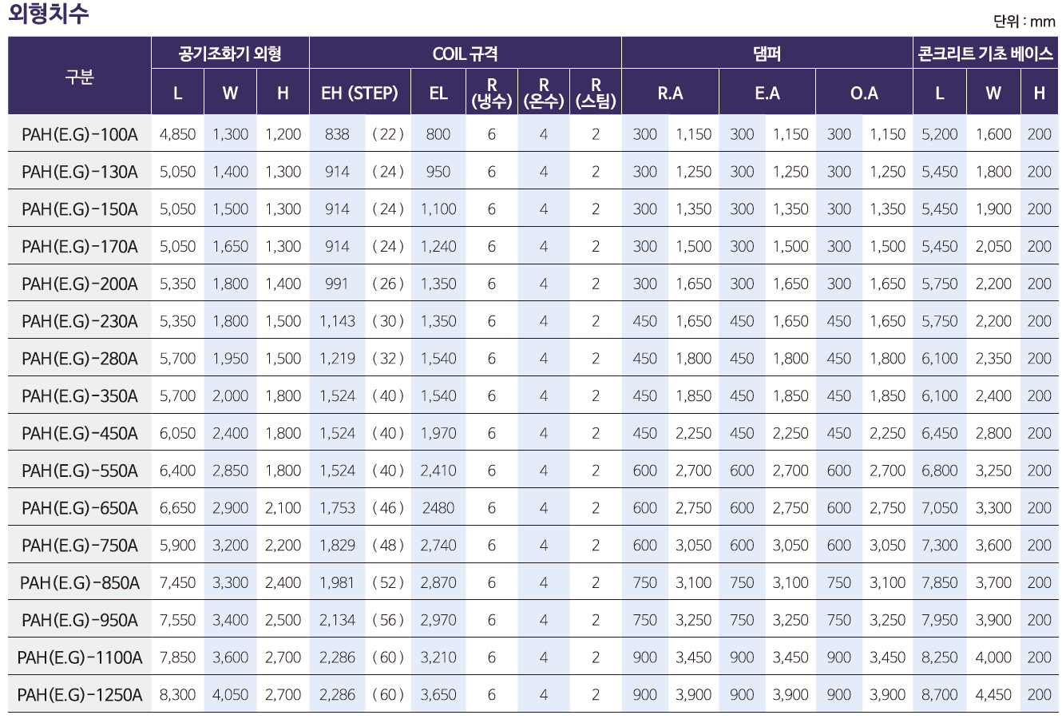
Air Handling Unit
PAH[E.G] 100A~1250A
DRYERKOREA CO.,LTD.

Slide 21
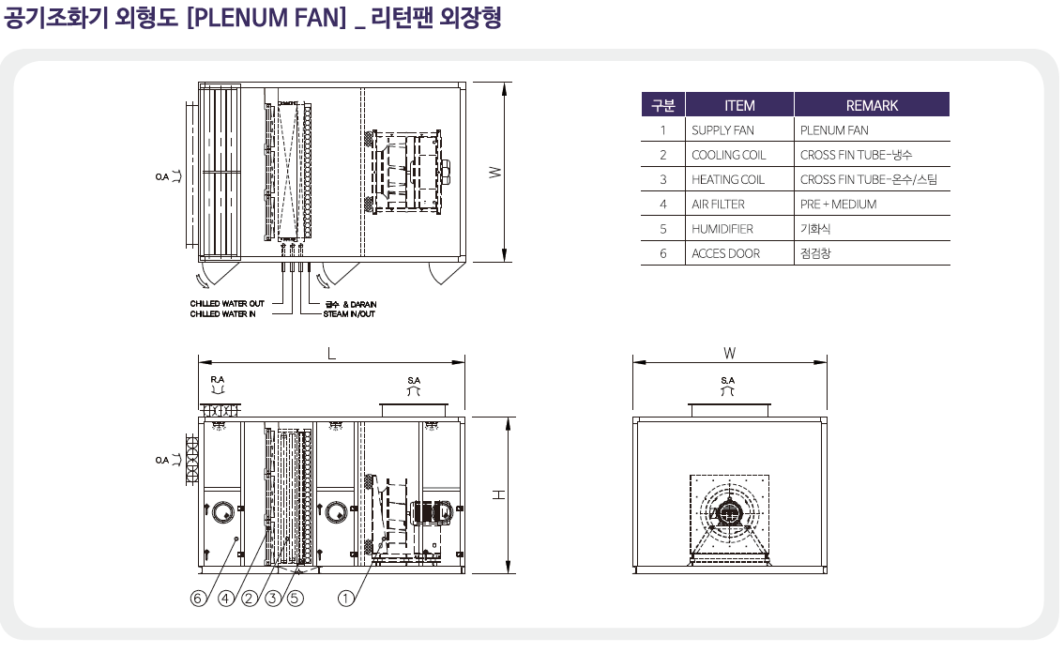
Air Handling Unit
PAH[E.G] 100A~1250A
DRYERKOREA CO.,LTD.

Slide 22
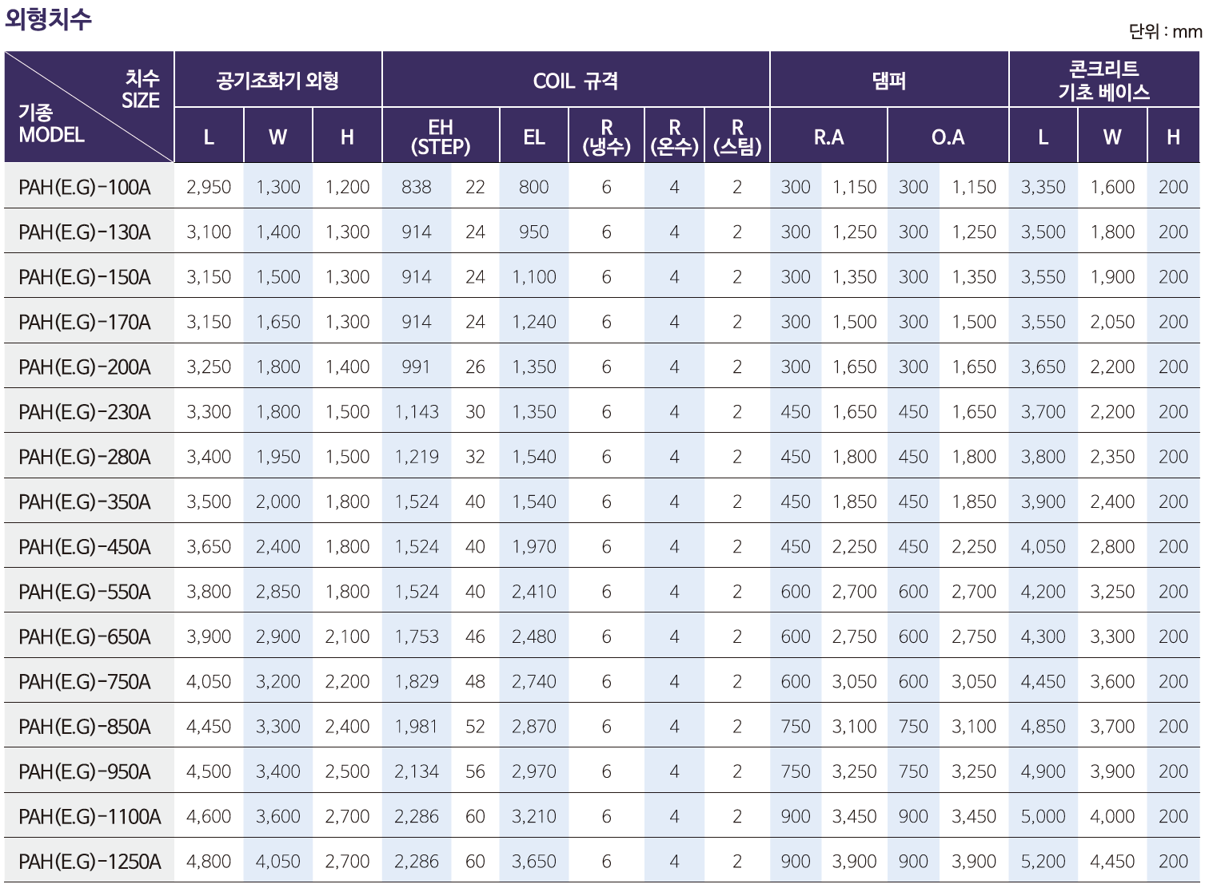
Air Handling Unit
PAH[E.G] 100A~1250A
DRYERKOREA CO.,LTD.

Slide 23
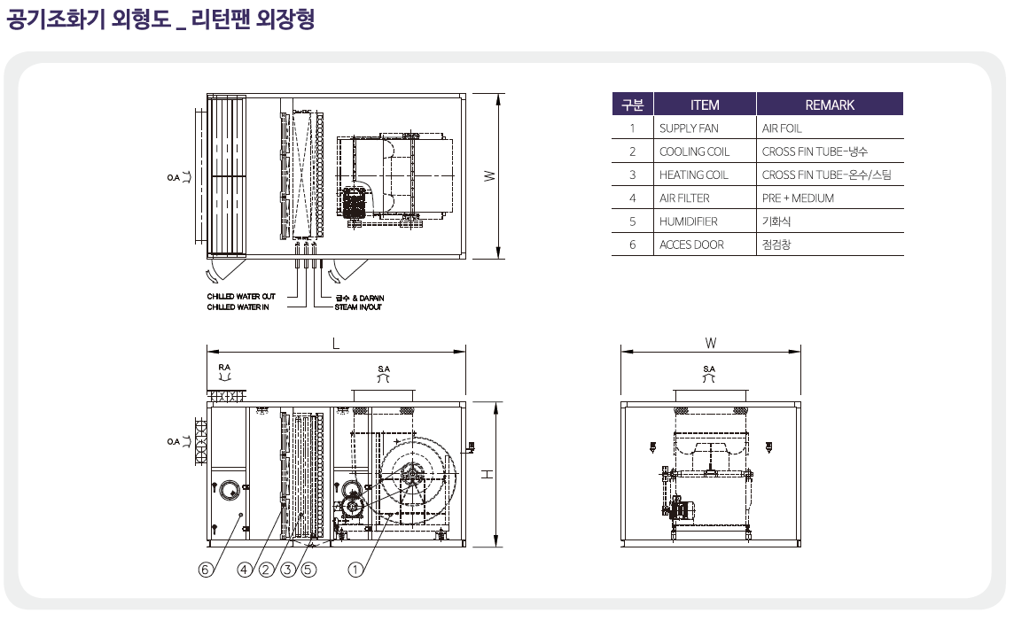
Air Handling Unit
PAH[E.G] 100A~1250A
DRYERKOREA CO.,LTD.

Slide 24
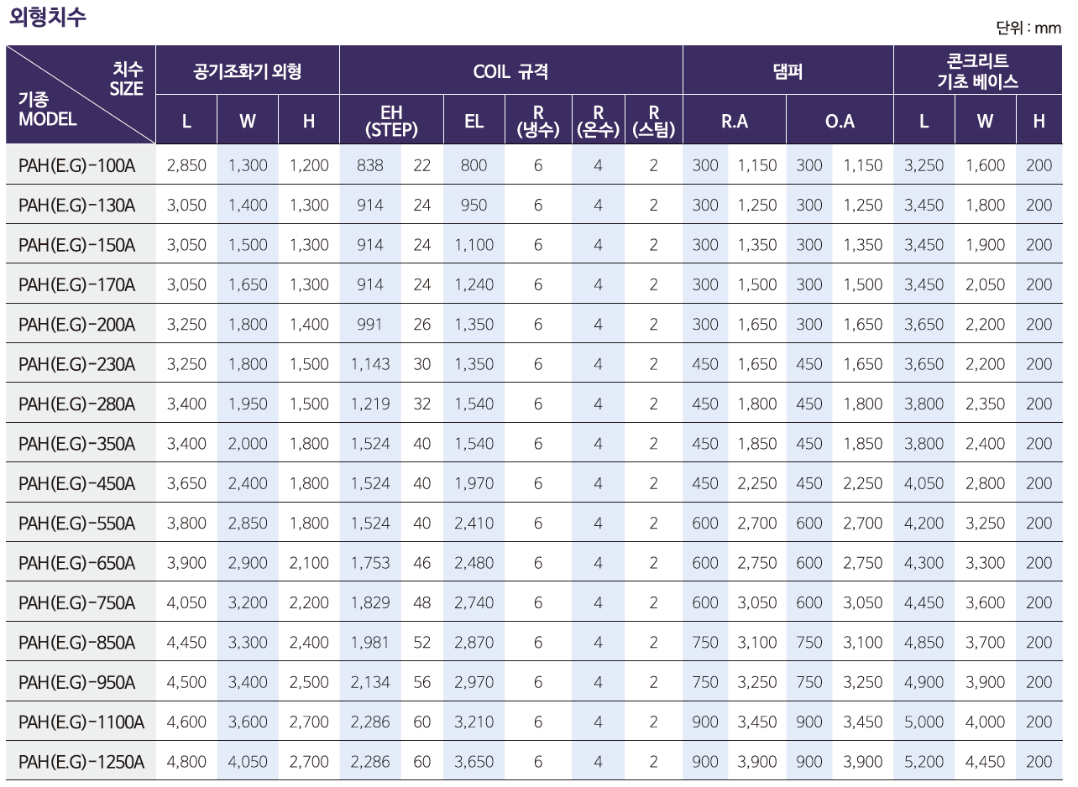
Air Handling Unit
PAH[E.G] 100A~1250A
DRYERKOREA CO.,LTD.

Slide 25
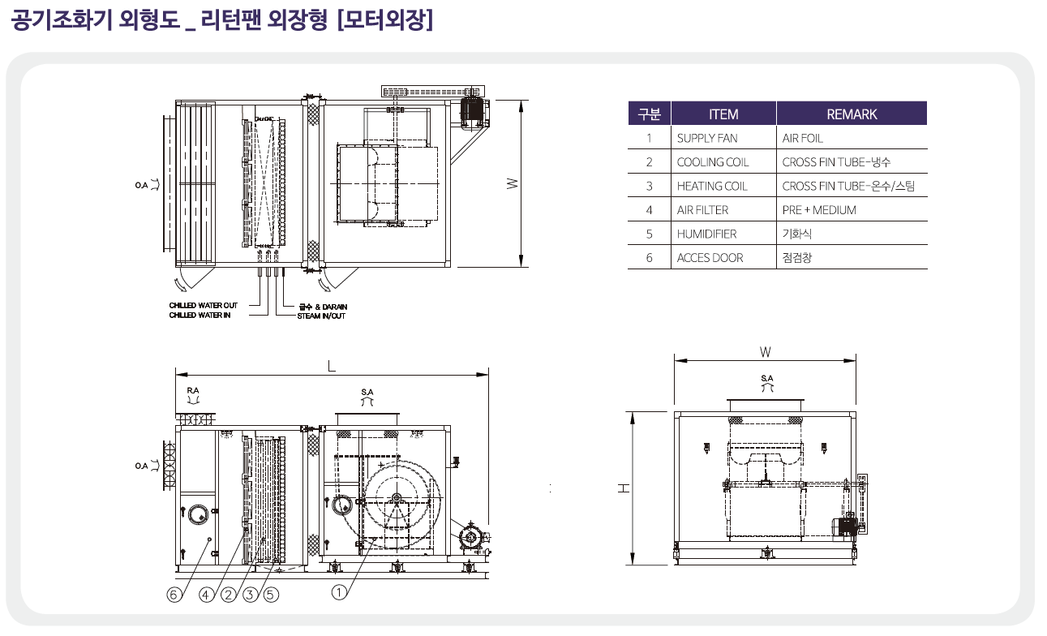
Air Handling Unit
PAH[E.G] 100A~1250A
DRYERKOREA CO.,LTD.

Slide 26
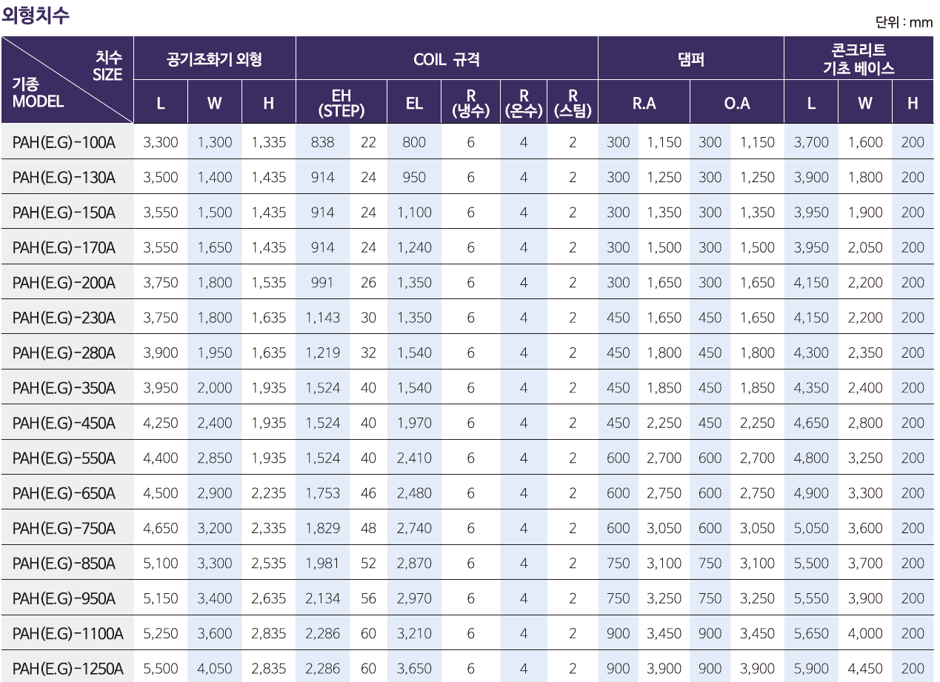
Air Handling Unit
PAH[E.G] 100A~1250A
DRYERKOREA CO.,LTD.

Slide 27
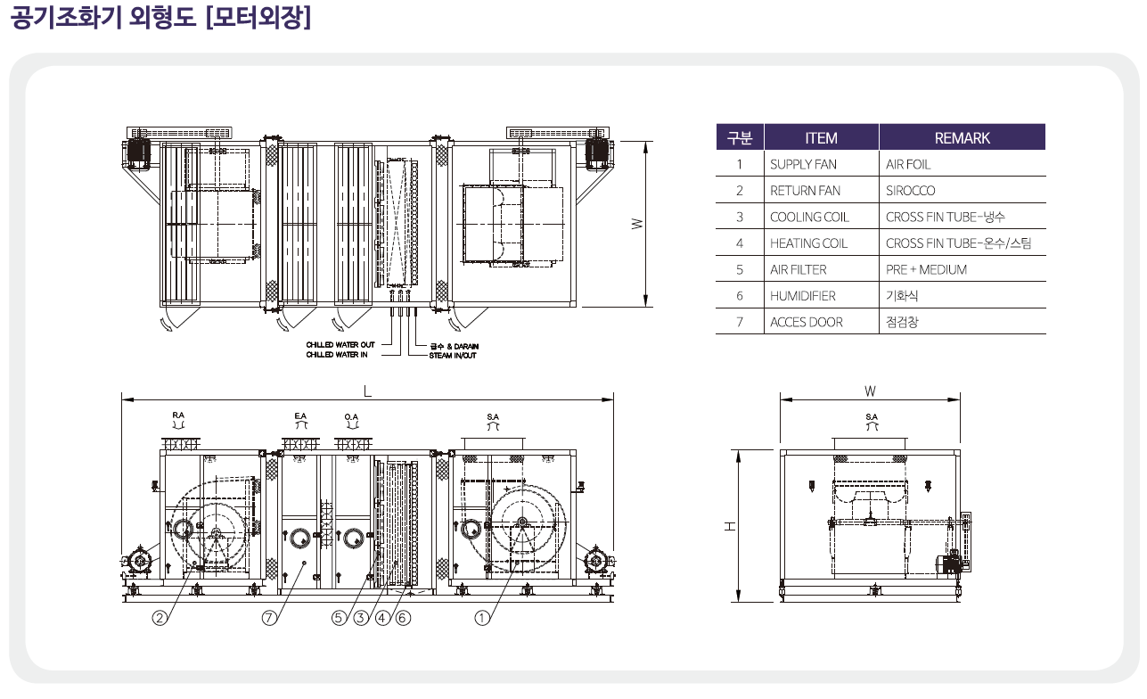
Air Handling Unit
PAH[E.G] 100A~1250A
DRYERKOREA CO.,LTD.

Slide 28
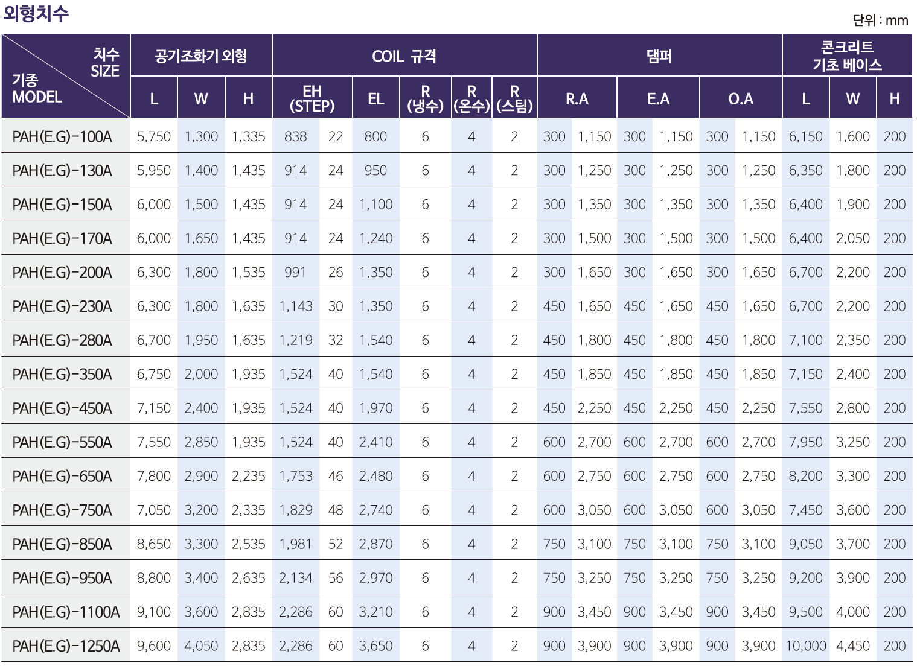
Air Handling Unit
PAH[E.G] 100A~1250A
DRYERKOREA CO.,LTD.

Slide 29
THANK YOU
Address： 50-16, Gwangnaman-ro, Gwangju-si, Gyeonggi-do, Republic of Korea
TEL : 031) 765 – 2162 FAX: 031) 765 - 2163
Homepage : www.dryerkorea.com

